Slide 1
Switching and Routing Essentials
CT122-3-2 SRE
Revision on IP Addressing

Slide 2
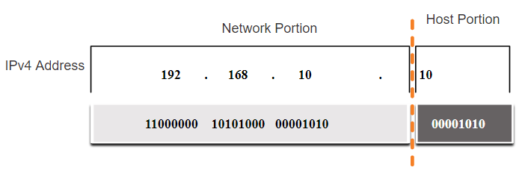
IPv4 Address Structure
Network and Host Portions
An IPv4 address is a 32-bit hierarchical address that is made up of a network portion and a host portion.
When determining the network portion versus the host portion, you must look at the 32-bit stream.
A subnet mask is used to determine the network and host portions.
Notes:
11 – IPv4 Addressing
11.1 – IPv4 Address Structure
11.1.1 – Network and Host Portions

Slide 3
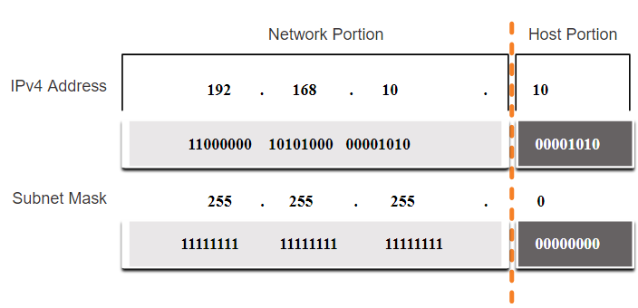
IPv4 Address Structure
The Subnet Mask
To identify the network and host portions of an IPv4 address, the subnet mask is compared to the IPv4 address bit for bit, from left to right.
The actual process used to identify the network and host portions is called ANDing.
Notes:
11 – IPv4 Addressing
11.1 – IPv4 Address Structure
11.1.2 – The Subnet Mask

Slide 4
IPv4 Address Structure
The Prefix Length
A prefix length is a less cumbersome method used to identify a subnet mask address.
Subnet Mask | 32-bit Address | Prefix Length
255.0.0.0 | 11111111.00000000.00000000.00000000 | /8
255.255.0.0 | 11111111.11111111.00000000.00000000 | /16
255.255.255.0 | 11111111.11111111.11111111.00000000 | /24
255.255.255.128 | 11111111.11111111.11111111.10000000 | /25
255.255.255.192 | 11111111.11111111.11111111.11000000 | /26
255.255.255.224 | 11111111.11111111.11111111.11100000 | /27
255.255.255.240 | 11111111.11111111.11111111.11110000 | /28
255.255.255.248 | 11111111.11111111.11111111.11111000 | /29
255.255.255.252 | 11111111.11111111.11111111.11111100 | /30
The prefix length is the number of bits set to 1 in the subnet mask.
It is written in “slash notation” therefore, count the number of bits in the subnet mask and prepend it with a slash.
Notes:
11 – IPv4 Addressing
11.1 – IPv4 Address Structure
11.1.3 – The Prefix Length

Slide 5
Types of IPv4 Addresses
Public and Private IPv4 Addresses
As defined in in RFC 1918, public IPv4 addresses are globally routed between internet service provider (ISP) routers.
However, private addresses are not globally routable.
Private addresses are common blocks of addresses used by most organizations to assign IPv4 addresses to internal hosts.
Private IPv4 addresses are not unique and can be used internally within any network.
Network Address and Prefix | RFC 1918 Private Address Range
10.0.0.0/8 | 10.0.0.0 - 10.255.255.255
172.16.0.0/12 | 172.16.0.0 - 172.31.255.255
192.168.0.0/16 | 192.168.0.0 - 192.168.255.255
Notes:
11 – IPv4 Addressing
11.3 – Types of IPv4 Addresses
11.3.1 – Public and Private IPv4 Addresses

Slide 6
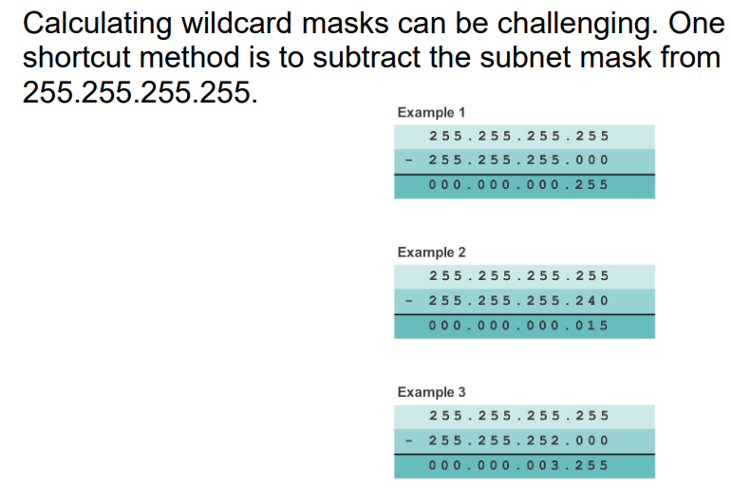
Wildcard mask for OSPF
Calculating the Wildcard Mask

Slide 7
Question and Answer Session
Q & A

Slide 8
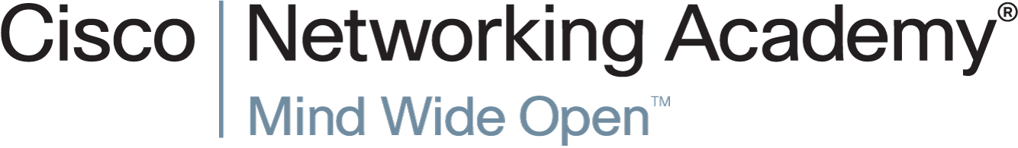

Slide 9
